Slide 1
Accreditation of health practitioners in Russia starting from 2016: answers to frequently asked questions

Slide 2
FAQ
WHAT IS ACCREDITATION?
WHAT CHANGES WILL OCCUR IN ADVANCED PROFESSIONAL TRAINING OF PHYSICIANS?
WHAT CREDENTIALS ARE REQUIRED FOR PHYSICIANS?
WHAT IS THE BEST WAY TO INTEGRATE INTO THE NEW SYSTEM OF TRAINING?
WHAT IS THE NON-GOVERNMENTAL SYSTEM OF PROFESSIONAL TRAINING FOR PHYSICIANS TO PREPARE FOR ACCREDITATION?

Slide 3
Question 1
WHAT IS ACCREDITATION?

Slide 4
Accreditation of health practitioners
PRIMARY
(upon graduation from medical school)
ACCREDITATION
SECONDARY
(for practicing physicians)
Secondary accreditation is a formal assessment process to evaluate an individual provider’s knowledge, skills, and educational experience and capability to provide quality care in a specific field.

Slide 5
Advanced professional training for physicians: current regulatory framework
Order of the Ministry of Health of Russia № 66n dated 3.08.2012 “On approval of the procedure for improving professional knowledge and skills of the health care providers and pharmaceutical staff through additional training in educational and research facilities”
Order of the Ministry of Education and Science of Russia № 499 dated 01.07.2013 “On approval of the procedure for setting up and implementation of continuing professional development activities”
section 12: the minimum duration of advanced training program is 16 hours.
section 14: a modular educational format using distance learning technologies and e-learning can be incorporated in the training process.

Slide 6
Question 2
WHAT CHANGES WILL OCCUR IN ADVANCED PROFESSIONAL TRAINING OF PHYSICIANS?

Slide 7
Preparation for accreditation
CME PROGRAMS
PREPARATION FOR ACCREDITATION
+
CPD PROGRAMS
CPD PROGRAMS
CERTIFICATION OF HEALTH PRACTITIONERS

Slide 8
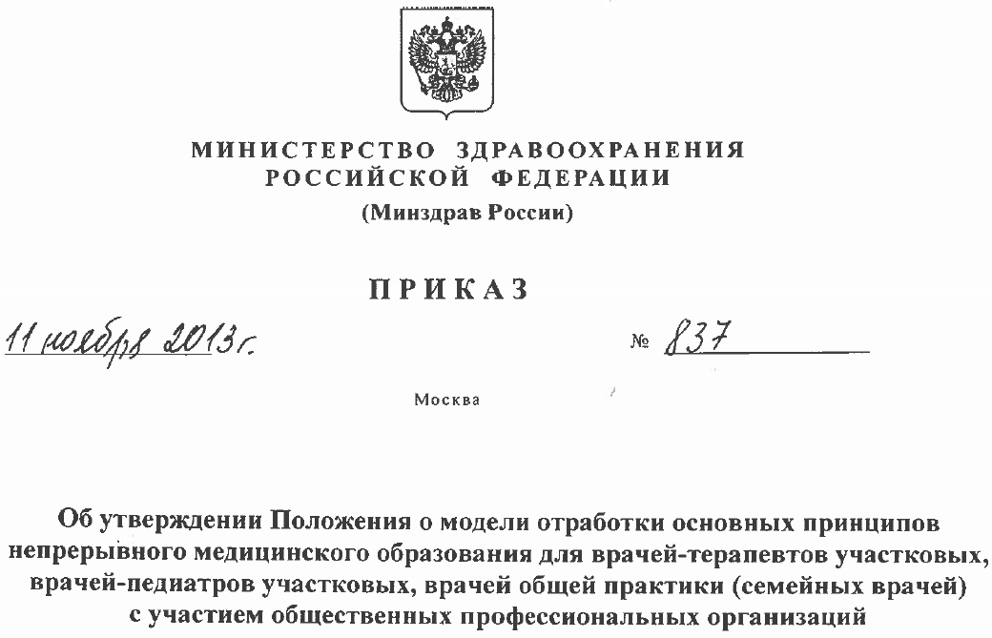
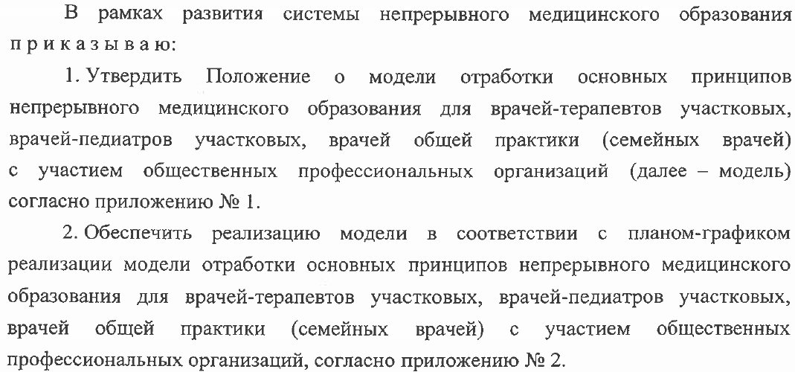
Pilot project in compliance with the Order of MoH № 837
THREE SPECIALTIES ONLY:
general practitioners, pediatricians, family medicine physicians

Slide 9
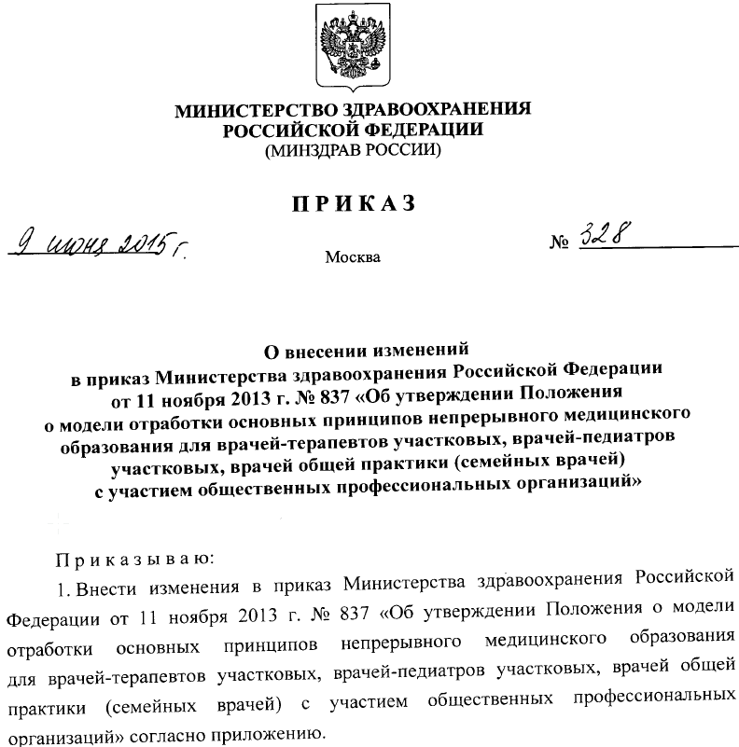
Pilot project was extended…
NO MIRACLE HAPPENED
Three specialties only:
general practitioners, pediatricians, family medicine physicians
up to 31.12.2020

Slide 10
Question 3
WHAT CREDENTIALS ARE REQUIRED FOR PHYSICIANS?

Slide 11
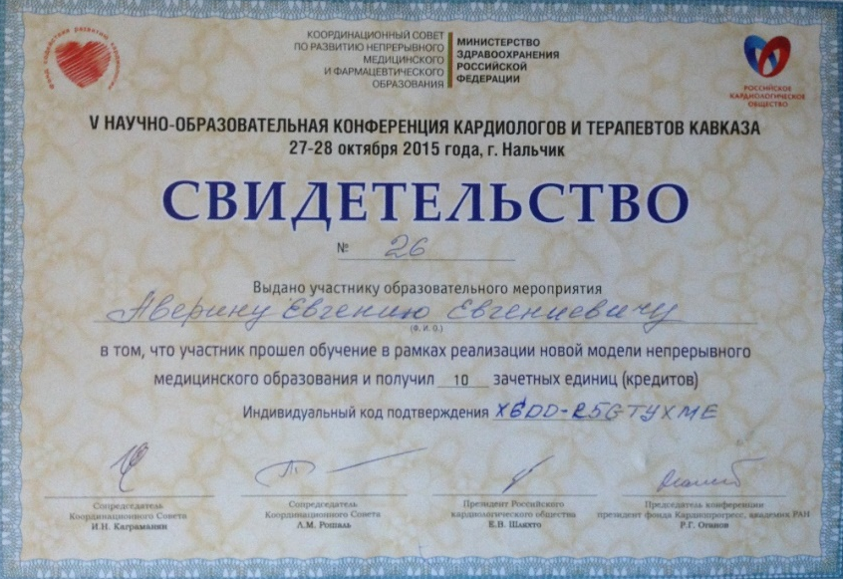
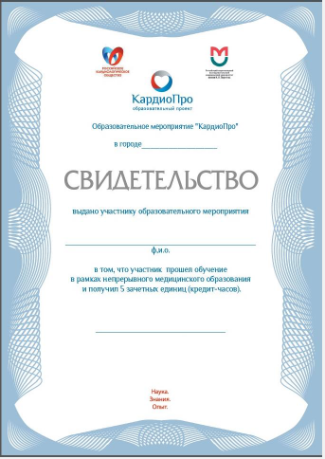
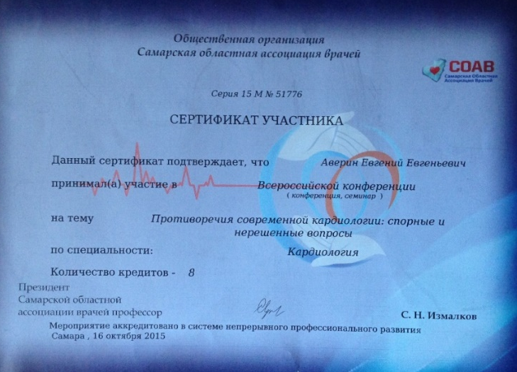
Recognition of credentials
There is no legal framework in place to recognize the following credentials when passing the qualifying certification exam.
Applying for a professional certificate/re-certification is contingent on meeting certain requirements such as completing approved CME program and having credentials that conform to the standard form.

Slide 12
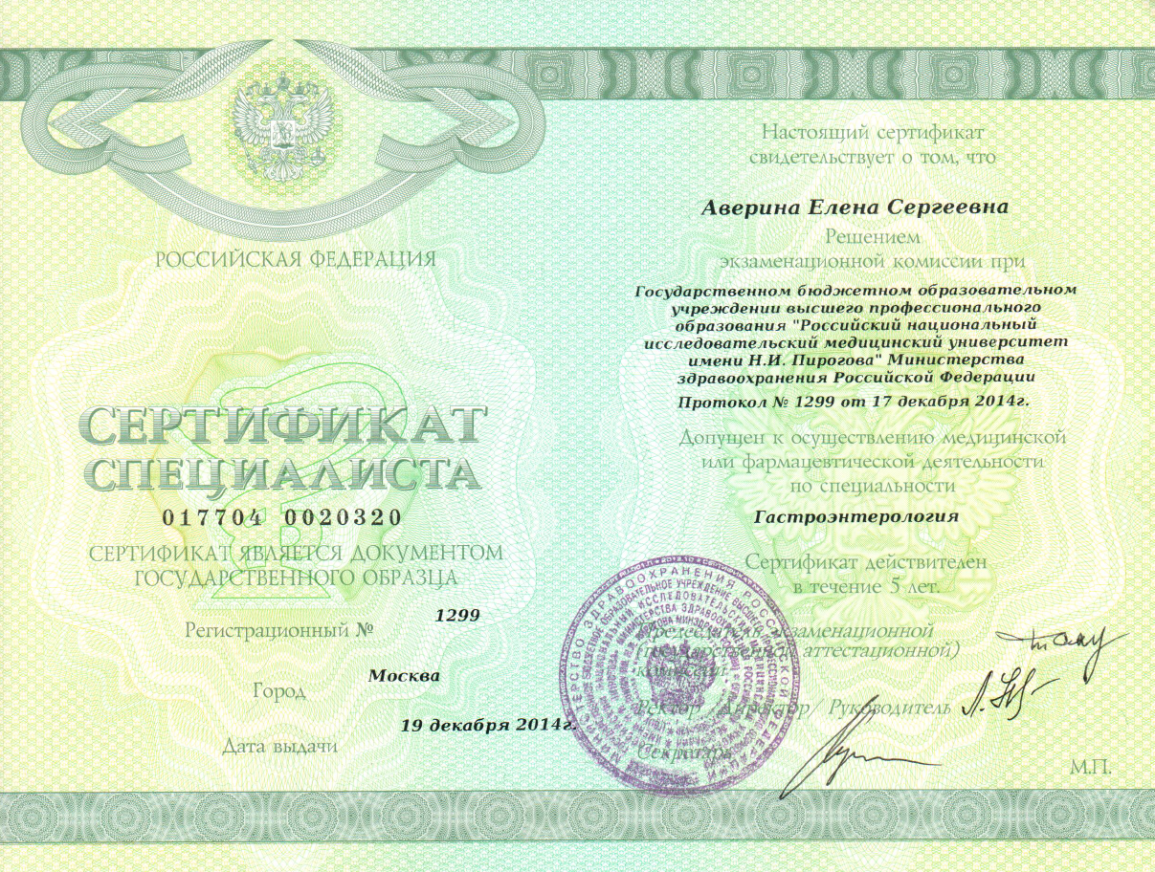
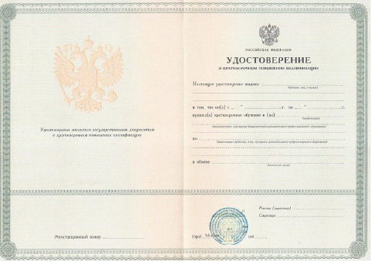
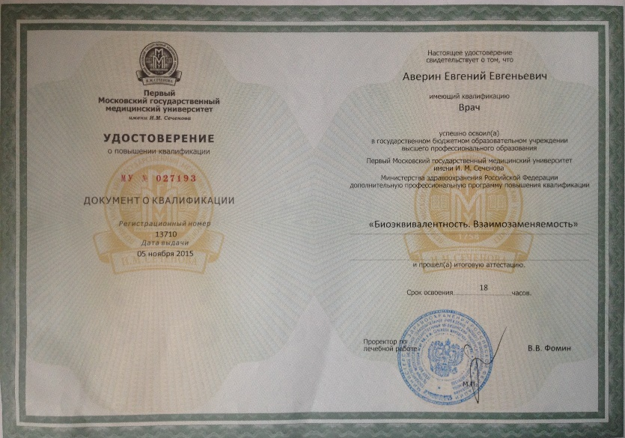
Standard form of credentials
STANDARD FORM OF CREDENTIALS may only be issued by an accredited CME provider

Slide 13
Question 4
WHAT IS THE BEST WAY TO INTEGRATE INTO THE NEW SYSTEM OF TRAINING?

Slide 14
Ways to integrate into the training process
CME PROGRAMS
25 %
36 hrs
PREPARATION FOR
ACCREDITATION
+
100 %
144 hrs
CPD PROGRAMS
75 %
108 hrs
25% of the training program: medical non-profit organizations
Medical School
75%
1st year 2nd year 3rd year 4th year 5th year

Slide 15
Non-governmental system of training /preparation for accreditation
PREPARATION FOR ACCREDITATION
100 %
144 hrs
NON-GOVERNMENTAL SYSTEM OF TRAINING /PREPARATION FOR ACCREDITATION INCLUDES:
OPTIONAL:
A physician may simultaneously enroll
in a CPD program
ON-SITE or DISTANCE LEARNING:
Practical workshops
Conferences and symposiums
Webinars and clinical case reports
Clinical case studies, etc.

Slide 16
Question 5
WHAT IS THE NON-GOVERNMENTAL SYSTEM OF PROFESSIONAL TRAINING FOR PHYSICIANS TO PREPARE FOR ACCREDITATION?

Slide 17
Non-governmental system of professional training for physicians: structure
Jan
Feb
Mar
Apr
May
Jun
Jul
Aug
Sep
Okt
Nov
Dec
Preparation
Content development
Content approval
Enrollment of physicians in CME
Training
On-site
(across Russia)
2 events in each city
2 events in each city
On-line
10-20 lectures
10-20 lectures
Treatment algorithms
(incl. mailout)
Development of audio / video educational content
Support
Documenting credit hours
>10,000 physicians
Joining clinical patient registries
Disease category or health technology / drug
Polling

Slide 18
Non-governmental system of professional training for physicians: options
MULTIPLE TOPIC AREAS WITHIN SPECIALTY
COMMON OPTION
PHYSICIANS WILL GET A CHANCE TO:
Renew a Practitioner Certificate
Obtain a Certificate of Advanced Training
Obtain a Certificate confirming completion of credit hours
TOPIC AREAS SELECTED BY THE CUSTOMER
INDIVIDUAL OPTION
PHYSICIANS WILL GET A CHANCE TO:
Obtain a Certificate of Advanced Training
Obtain a Certificate confirming completion of credit hours

Slide 19
Non-governmental system of professional training for physicians: opportunities
SYSTEM OF TRAINING AND ACTIVITIES
ON-SITE TRAINING
DISTANT LEARNING
Choosing:
1) Cities where the training will be held
2) Participants (physicians)
3) Event format
4) Speakers
5) Educational materials
6) Polling /questionnaire surveys
Choosing:
1) Module topics
2) Highlighting the key points
3) Module format
4) Speakers
5) Polling /mailouts

Slide 20
Which option shall we discuss?
!
?
?

Slide 21
THANK YOU FOR YOUR ATTENTION!

Slide 22
Contacts
Evgeniy Averin, MD, PhD, managing director, ANO ‘Medica-Mente’
Email: info@medica-mente.org
Phone: +7 (495) 181-58-42
Address: Novinskiy bvd., bld. 18, off. 1

